Slide 1
Health eDecisions Initiative – Closing Ceremony March 27, 2014
Notes:
Jamie

Slide 2
Agenda
Introduction
Doug Fridsma, M.D., PhD -Chief Science Officer & Director, Office of Science & Technology – Office of the National Coordinator
Background of HeD Initiative
Kensaku Kawamoto, MD, PhD Initiative Coordinator, Health eDecisions-Associate Chief Medical Information Officer, Univ. of Utah Health Sciences Center
Accomplishments
Howard Strasberg, MD, MS - VP Medical Informatics, Clinical Solutions -Wolters Kluwer
HeD Key Deliverable 1: Foundational CDS Information Model
Claude Nanjo M.P.H –Health eDecisions Subject Matter Expert-Sr. Software Architect ,Cognitive Medical Systems
HeD Key Deliverable 2: HL7 CDS Knowledge Artifact Implementation Guide (IG)
Aziz Boxwala, MD, PhD- Subject Matter Expert, Health eDecisions-President - Meliorix, Inc.
HeD Key Deliverable 3: HL7 Decision Support Service IG
Bryn Rhodes – Health eDecisions Subject Matter Expert – Software Architect , Veracity Solutions
Pilots
Julie Scherer, PhD-Chief Data Scientist -Motive Medical Intelligence
Robin Williams, RN - Manager Solution Management- Allscripts
Real World Applications
Daryl Chertcoff - Project Manager -HLN Consulting, LLC
Julie Scherer, PhD-Chief Data Scientist -Motive Medical Intelligence
Robin Williams, RN - Manager Solution Management- Allscripts
Howard Strasberg, MD, MS - VP Medical Informatics, Clinical Solutions -Wolters Kluwer
Path Forward
Kensaku Kawamoto, MD, PhD
Notes:
Ken

Slide 3
HeD Goal
To define and validate standards that facilitate the emergence of systems and services whereby CDS interventions can be shared or accessed by any healthcare stakeholder via an importable format or via a CDS Web service
In short, to define and validate standards that enable CDS sharing at scale
Notes:
Ken

Slide 4
Health eDecisions (HeD)
ONC-sponsored, public-private initiative to develop and validate standards to enable CDS at scale (http://wiki.siframework.org/Health+eDecisions+Homepage )
Seek to inform future MU EHR certification criteria
Brief timeline
April 2012: face-to-face planning discussion, DC
June 2012: initiative kickoff
Jan, May, Sept 2013, Jan 2014: HL7 ballots
March 2013+: pilots
Early 2014: Draft NRPM comments for 2015 Voluntary EHR Certification, finalize ballots, publish final artifacts through HL7
Notes:
Ken

Slide 5
Relevant Prior Work
Standard, universal format for CDS knowledge
HL7 Arden Syntax, HL7 GELLO, HL7 Order Sets, ASTM GEM, GLIF3, CDS Consortium L3 model, SAGE, Asbru, PROforma, PRODIGY, AHRQ eRecommendations, etc.
Standard interface for submitting patient data and obtaining patient-specific care guidance
HL7 Decision Support Service
OpenCDS, CDS Consortium ECRS, SEBASTIAN, etc.
Standard information model for CDS
HL7 Virtual Medical Record
Ref. Kawamoto K et al. Open Medical Informatics Journal. 2010, 4:235-44.
Notes:
Ken – high level

Slide 6
Accomplishments
Howard Strasberg, MD, MS
VP Medical Informatics, Clinical Solutions Wolters Kluwer
Notes:
Ken

Slide 7
We did it…
The HeD community drafted and established consensus for 2 complete Use Cases:
Use Case 1 and Functional Requirements: CDS Artifact Sharing
Use Case 2: CDS Guidance as a Service (including Functional Requirements)
We have submitted 6 artifacts to HL7 which are all now Draft Standards for Trial Use (DSTU)
Clinical Decision Support Knowledge Artifact Implementation Guide (UC 1)
Rules, Order Sets and Documentation Templates
Decision Support Service (DSS) Implementation Guide (UC 2)
Virtual Medical Record (vMR) Logical Model
vMR XML Specification
vMR Templates
DSS Standard
We have completed pilots for both use cases which include 5 pilot ecosystems
Formal pilots for UC 1
Pilots of slightly earlier versions of standards for UC 2
We have been included in the proposed voluntary 2015 EHR Certification Criteria
Notes:
Howard
Notes: We want to be careful about the piloting of UC 2 – the wording should be that we piloted different parts of HeD specifically vMR and an earlier version of the standard

Slide 8

Standards Overview
Specification | Description | Status
Knowledge Artifact IG R1 (Use Case 1) | CDS artifact schema | DSTU Published
Decision Support Service IG R1 (Use Case 2) | IG for CDS Web services for US Realm | DSTU Published
VMR Logical Model R2 | UML data model for CDS | DSTU Submitted for Publication
VMR Templates R1 | Terminology bindings and other constraints | DSTU Submitted for Publication
VMR XML Specification R1 | XML schema for CDS input and output | DSTU Submitted for Publication
Decision Support Service R2 | CDS Web service framework | DSTU Published
Notes:
Howard

Slide 9
HeD Key Deliverable 1: Foundational CDS Information Model
Claude Nanjo M.P.H
Sr. Software Architect, Cognitive Medical Systems
Subject Matter Expert, Health eDecisions
Notes:
Claude

Slide 10
Underlying Information Model
Need
Standard CDS data model that is simple and intuitive for a typical CDS knowledge engineer to understand and use
Relevant Prior Work Evaluated
HL7 Consolidated Clinical Document Architecture (C-CDA)
HL7 Quality Reporting Document Architecture (QRDA)
HL7 Fast Healthcare Interoperability Resources (FHIR)
HL7 Virtual Medical Record (vMR)
IHC Clinical Element Models, OpenEHR templates, others
Decision
HL7 vMR with templates derived from C-CDA and QRDA
Notes:
Claude

Slide 11
Example Challenge without VMR
Blood Pressure
Systolic = 120 mmHg
Diastolic = 80 mmHg
Code = BP
Value = 120/80 mmHg
Observation
Code = BP
Value = 120/80 mmHg
Observation
Code = BP
Observation
Code = SBP
Value = 120 mmHG
Observation
Code = DSP
Value = 80 mmHg
Vital Signs
Type = BP
Value = 120/80
Units = mmHg
Notes:
SCT 14May
Claude

Slide 12
Why Not Just Use C-CDA as the vMR?
<entry
typeCode="DRIV">
<act classCode="ACT" moodCode="EVN">
<templateId root="2.16.840.1.113883.10.20.22.4.3"/>
<id root="ec8a6ff8-ed4b-4f7e-82c3-e98e58b45de7"/>
<code code="CONC" codeSystem="2.16.840.1.113883.5.6" displayName="Concern"/>
<statusCode code="completed"/>
<effectiveTime><low value="20070103"/></effectiveTime>
<entryRelationship typeCode="SUBJ">
<observation classCode="OBS" moodCode="EVN">
<templateId root="2.16.840.1.113883.10.20.22.4.4"/>
<id root="ab1791b0-5c71-11db-b0de-0800200c9a66"/>
<code code="409586006" codeSystem="2.16.840.1.113883.6.96" displayName="Complaint"/>
<statusCode code="completed"/>
<effectiveTime><low value="19500101"/></effectiveTime>
<value xsi:type="CD" code="195967001" codeSystem="2.16.840.1.113883.6.96" displayName="Asthma"/>
<entryRelationship typeCode="REFR">
<observation classCode="OBS" moodCode="EVN">
<templateId root="2.16.840.1.113883.10.20.22.4.6"/>
<code xsi:type="CE" code="33999-4" codeSystem="2.16.840.1.113883.6.1" codeSystemName="LOINC"
displayName="Status"/>
<statusCode code="completed"/>
<value xsi:type="CD" code="55561003" codeSystem="2.16.840.1.113883.6.96"
codeSystemName="SNOMED CT" displayName="Active"/>
</observation>
</entryRelationship>
</observation>
</entryRelationship>
</act>
</entry>
CCDA 1.1 representation of
“Patient has had asthma since 1950”
Notes:
Claude

Slide 13
Why Not Just Use C-CDA as the vMR?
Sample CDS expression that
“Patient currently has active asthma”
using CCDA 1.1 Data Model
entry[@typeCode=“DRIV” and
act[@classCode=“ACT” and
@moodCode=“EVN” and
templateId[@root=“2.16.840.1.113883.10.20.22.4.3”] and
code[@codeSystem=“2.16.840.1.113883.5.6” and @code=“CONC”] and
statusCode[@code=“completed”] and
entryRelationship[@typeCode=“SUBJ” and
observation[@classCode=“OBS” and @moodCode=“EVN” and
templateId[@root=“2.16.840.1.113883.10.20.22.4.4”] and
code[@codeSystem=“2.16.840.1.113883.6.96” and @code=“409586006”] and
statusCode[@code=“completed”] and
effectiveTime[low[@value<=“20130814”]] and
value[@xsi:type=“CD” and @codeSystem=“2.16.840.1.113883.6.96” and @code=“95967001”] and
entryRelationship[@typeCode=“REFR” and
observation[@classCode=“OBS” and @moodCode=“EVN” and
templateId[@root=“2.16.840.1.113883.10.20.22.4.6”] and
code[@xsi:type=“CE” and
@codeSystem=“2.16.840.1.113883.6.1” and
@code=“33999-4”
] and
statusCode[@code=“completed”] and
value [@xsi:type=“CD” and
@codeSystem=“2.16.840.1.113883.6.96” and
@code=“55561003”
] ] ] ] ] ]
Notes:
Claude

Slide 14
vMR Representation of Equivalent Content
vMR representation of “Patient has had asthma since 1950”
<clinicalStatement xsi:type="vmr:Problem">
<templateId root="2.16.840.1.113883.3.1829.11.7.2.5"/>
<conditionCode codeSystem="2.16.840.1.113883.6.96" code="195967001"><displayName value="Asthma"/></conditionCode>
<conditionEffectiveTime><low value="19500101"/><conditionEffectiveTime>
<conditionStatus codeSystem="2.16.840.1.113883.6.96" code="55561003"><displayName value="Active"/></conditionStatus>
</clinicalStatement>
Sample CDS expression for “Patient currently has active asthma” using vMR
clinicalStatement[@xsi:type=“vmr:Problem” and
templateId[@root=“2.16.840.1.113883.3.1829.11.7.2.5”] and
conditionCode[@codeSystem=“2.16.840.1.113883.6.96” and @code=“195967001”] and
conditionEffectiveTime[low[@value<=“20130814”]] and
conditionStatus[@codeSystem=“2.16.840.1.113883.6.96” and @code=“55561003”] ]
Notes:
Claude

Slide 15
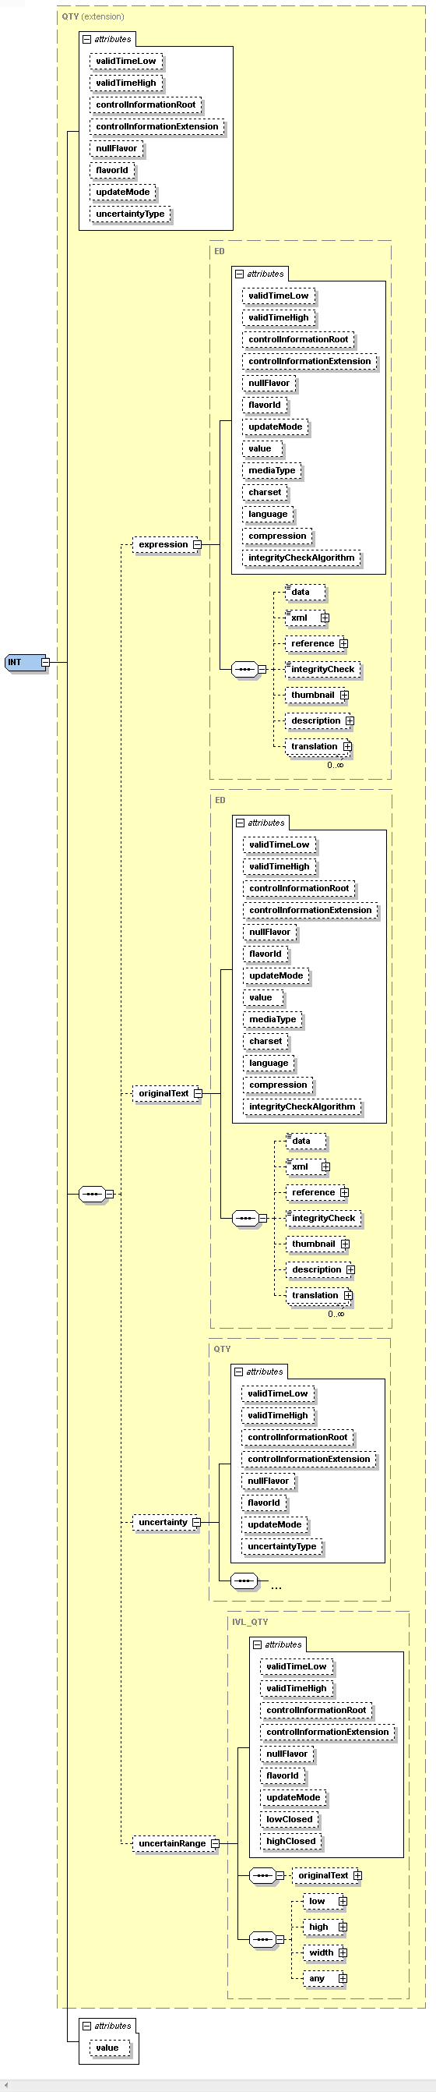
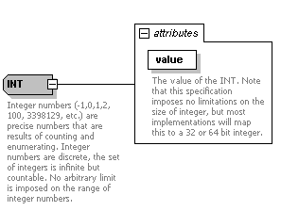
Simplification – Data Types
HL7 Version 3 Release 2 Data
Type Model for Integer
Constrained HL7 Version 3 Release 2 Data Type Model for Integer used in vMR
Value of the INT
Notes:
SCT 14May
Claude

Slide 16
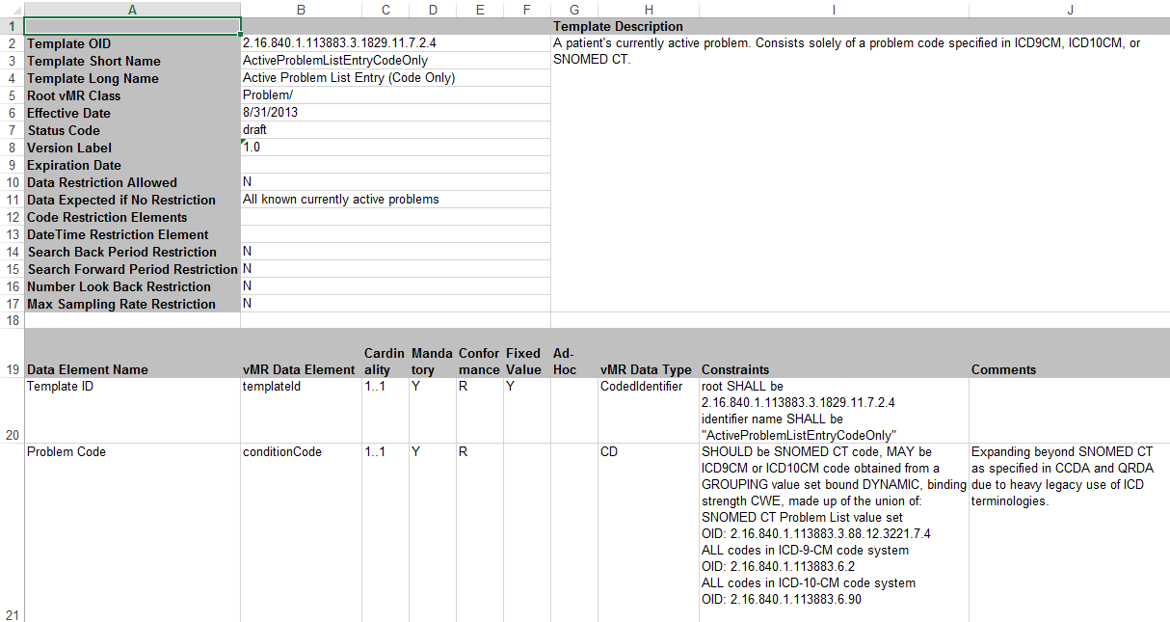
Example vMR Template
Example:
<clinicalStatement xsi:type="vmr:Problem">
<templateId root="2.16.840.1.113883.3.1829.11.7.2.4“ identifierName=“ActiveProblemListEntryCodeOnly”/>
<conditionCode codeSystem="2.16.840.1.113883.6.96" code="195967001"><displayName value="Asthma"/></conditionCode>
</clinicalStatement>
Notes:
Claude

Slide 17
HeD Key Deliverable 2: HL7 CDS Knowledge Artifact Implementation Guide (IG) (HeD Use Case 1 IG)
Aziz Boxwala, MD, PhD
President, Meliorix, Inc.
Subject Matter Expert, Health eDecisions
Notes:
Aziz

Slide 18
Goal
CDS interventions must be made shareable and implementable so that they can be acquired and deployed by any organization.
Notes:
Aziz

Slide 19
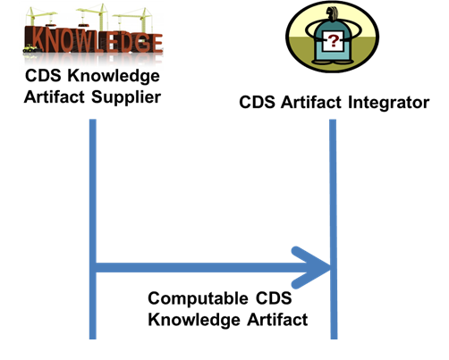
Use Case Overview
Notes:
Aziz

Slide 20
Knowledge Artifact Schema
Schemas defined by composition of components
Currently supported CDS interventions
Event-condition-action rules
Order sets
Structured documentation templates
In future, can be expanded
E.g., Plans of care, infobutton rules/knowledge, relevant data display
Notes:
Aziz

Slide 21
External Data Example
Addressing the curly braces issue using HeD expression language and the VMR
<def name="PertussisProblems">
<expression xsi:type="ClinicalRequest" dataType="vmr:Problem" cardinality="Multiple“ isInitial="true" useValueSets="true" dateProperty="diagnosticEventTime.begin" codeProperty="problemCode" triggerType="DataElementAdded">
<description>Pertussis problem</description>
<codes xsi:type="ValueSet" id="2.16.840.1.114222.4.11.7005" version="1"/>
</expression>
</def>
Notes:
Aziz

Slide 22
Conditions Example
<condition>
<logic xsi:type="And">
<description>(Patient lives in SD or Care encounter was in SD) and
(Diagnosed with Pertussis or Cause of Death was Pertussis
or culture results positive for pertussis)</description>
<operand xsi:type="Or">
<operand xsi:type="ExpressionRef" name="PatientLivesInSDCounty"/>
<operand xsi:type="ExpressionRef" name="EncounterWasInSDCounty"/>
</operand>
<operand xsi:type="Or">
<!-- Necessary clinical conditions -->
<operand xsi:type="ExpressionRef" name="HasActivePertussisProblems"/>
<operand xsi:type="ExpressionRef" name="DeathWasCausedByPertussis"/>
<operand xsi:type="ExpressionRef" name="HasPositivePertussisCulture"/>
</operand>
</logic>
<conditionRole value="ApplicableScenario"/>
</condition>
Notes:
Aziz

Slide 23
Communication Action
<simpleAction xsi:type="CreateAction">
<actionSentence xsi:type="ObjectExpression"
objectType="vmr:CommunicationProposal">
<property name="message">
<value xsi:type="ComplexLiteral">
<value xsi:type="dt:ED" value="This patient has or is suspected of having pertussis. Patients diagnosed with or suspected of having pertussis must be reported to County of San Diego Health and Human Services Agency within one working day of identification or suspicion"/>
</value>
</property>
</actionSentence>
</simpleAction>
Notes:
Aziz

Slide 24
HeD Key Deliverable 3: HL7 Decision Support Service IG (HeD Use Case 2 IG)
Bryn Rhodes
Software Architect, Veracity Solutions.
Subject Matter Expert, Health eDecisions
Notes:
Bryn

Slide 25
Goal
Allow any organization to easily obtain CDS guidance through a secure, standard Web service interface.
Notes:
Bryn

Slide 26

Use Case Overview
CDS Guidance Requestor
CDS Guidance Supplier
CDS Request
(patient data)
CDS Guidance
(care guidance)
Notes:
Bryn

Slide 27
Sample CDS Guidance Services
Evaluation Input | Evaluation Output
Patient age, gender, past health maintenance procedures | List of health maintenance procedures due or almost due
Medication identifier, age, gender, weight, serum creatinine level | Recommended maximum and minimum doses for medication given patient's estimated renal function
Insurance provider, data relevant to prescription | Prior authorization to prescribe medication
Patient summary | Wide range of care recommendations
Notes:
SCT 14May
Bryn

Slide 28
Key Standards
HL7 Decision Support Service (DSS)
Defines SOAP and REST Web service interfaces for CDS guidance services
HL7 Virtual Medical Record (vMR)
Provides easy-to-understand data model for CDS
HL7 Consolidated CDA (C-CDA) and Quality Reporting Document Architecture (QRDA)
Terminology bindings and value sets largely being adopted within vMR as vMR templates
Notes:
Bryn

Slide 29
Sample CDS Guidance Service Implementers
OpenCDS (www.opencds.org)
Multi-institutional open-source effort led by Univ. of Utah
Implements HL7 DSS and vMR; will support HeD UC 2
200+ members from 150+ organizations
Example implementation: Immunization Calculation Engine (ICE), led by HLN Consulting, and used by eClinicalWorks
Enterprise Clinical Rules Service
Part of CDS Consortium effort
Epic EHR
Will support CDS Guidance Services in 2014 release
Notes:
Bryn note that these are implementers of CDS – only the first one is DSS vMR compliant

Slide 30
Use Case 1 Pilots
Julie Scherer, PhD
Chief Data Scientist , Motive Medical Intelligence
Robin Williams, RN
Manager Solution Management, Allscripts
Notes:
Julie and Robin

Slide 31
Use Case 1 Pilots Goal
Goal
The goal of this pilot is to produce, consume, and, where feasible, execute implementable CDS interventions.
Event condition action rules (ECA Rules)
Order sets
Documentation templates
Pilot Scope
Apply defined aspects of the Implementation Guide in a real-world setting.
Modify the Implementation Guide to ensure it is usable.
Submit explicit feedback to sub-workgroups such as vMR and vocabulary and terminology to close gaps.
Evaluate the technology, standards, and model (VMR).
Provide a test bed to evaluate the interaction of technology, implementation support, and operational infrastructure required to meet Health eDecisions’ use case 1 objectives at the stakeholder or organization levels.
Demonstrate that intents of artifacts (including structures and semantics) are communicated either by direct execution or by translation to native format.
Ensure completeness and consumability of artifacts.
Notes:
Julie

Slide 32
UC 1 Pilot Teams
EHR/Vendor | Artifact to Pilot | Content Supplier
Allscripts Robin Williams, RN, Manager Solution Management Manoj Sharma Senior Software Engineer, Analytics & Information Business (AIB) | ECA rule: NQMF 068 Million Hearts™ Rule | Motive Medical Intelligence (formerly newMentor) Julie A. Scherer, PhD Chief Data Scientist
Allscripts Robin Williams RN, Manager Solution Management Manoj Sharma Senior Software Engineer, Analytics & Information Business (AIB) | ECA rule: San Diego Pertussis | CDC Shu McGarvey, CBAP (Northrop Grumman) Laura Conn, MPH (CDC Pilot Sponsor) Rita Altamore, MD, MPH (SME) Catherine Staes, BSN, MPH, PhD (SME)
VA Kensaku Kawamoto, MD, PhD Associate Chief Medical Information Officer Assistant Professor, Department of Biomedical Informatics University of Utah Robert Lario MSE, MBA CEO, Visumpoint | Documentation Template: UTI (Partial History and Physical) | Wolters Kluwer Christy May, MS, RHIA
Design Clinicals Dewey Howell, MD, PhD Founder, CEO | Order Set: Heart Failure | Zynx Health Victor Lee, MD Vice President, Clinical Informatics Claude Nanjo Senior Software Architect
Notes:
Julie

Slide 33
UC 1 Pilot Findings
Syntax translation was straightforward
Shared heritage of HeD and CREF provided very close mapping of operators
Data model translation required changes to the rule implementation
Negation rationale: observation of documented reason for not prescribing versus allergy to aspirin
Medication: aspirin as a substance versus antithrombotic therapy as a class
Procedures: performed procedure versus encounters with procedure code
Gaps in guidance modeling
Action models differed in messaging granularity, specificity of severity, and action proposal architecture
HeD rule implementation was modified to meet CREF requirements
We could represent the reporting criteria in a fully computable manner in HeD
HeD's expressivity exceeded that of the target's systems rule capabilities in one area (but there was an approach to achieve almost equivalent functionality in the vendor system)
The process revealed gaps in the vendor’s CDS (e.g., location of encounter), resulting in plans to add new capability based on lessons learned from the pilot
A standard terminology for orders would be helpful for CDS and would benefit Health eDecisions Use Case 1 and 2
Meanwhile, terminology guidance needs to be more prescriptive
Notes:
Robin

Slide 34
In Support of UC 1 Pilots: HeD Schema Framework Tool
HeD Schema Framework is a set of .NET technologies that serves as a foundation for implementing functionality related to the HeD Schema
For example, the following types of applications could be built using the foundation provided by this framework:
Semantic Validation
Translation
Evaluation
Visual Designers
Developed as Open Source with a Berkeley 3-Clause License
Hosted on Google Code Repository
http://code.google.com/p/health-e-decisions/
http://code.google.com/p/health-e-decisions/source/browse/trunk/src/framework/Deploy/HeDArtifactUtility_20130502.zip
Notes:
Bryn – this needs to be high level (no technical details)

Slide 35
Application of Use Case 2: Immunization Calculation Engine (ICE)
Open Source Immunization Decision Support System
for Integration with Health Information Systems
Daryl Chertcoff
Project Manager
HLN Consulting, LLC
URL: www.hln.com/ice
Email: ice@hln.com
Notes:
Daryl

Slide 36
Agenda
Overview of the ICE Project and Software
Lessons Learned (and continue to learn!)
Questions

Slide 37
Overview of the ICE Project
Notes:
37

Slide 38
Immunization Forecasting Isn’t Easy…
Increasingly complex rules
Evolving recommendations from ACIP
Increasing pressure to collaborate with the larger Health IT landscape
Ongoing use of aging software architectures, despite growing demand
Competitive funding environment
38

Slide 39
ICE Project Goals
“Create a freely available
immunization decision support system that promotes clinical best practices,
adapts to changing requirements,
and easily integrates with other health information systems.”
Notes:
One strategy is to collaborate with other organizations that are trying to solve the same problem.
Pool your resources and jointly develop a shared solution.
That is precisely the approach that the ICE team has taken to implement the Immunization Calculation Engine.
The New York City CIR, HLN, Alabama, and the OpenCDS Team have been working together closely for two years to produce ICE.

Slide 40
ICE Project Principles
Collaborative
Leverage the experience of CDS and immunization professionals (including but not limited to)
New York City Citywide Immunization Registry
Alabama Department of Public Health
CDS software and standards innovators (CDC CDSi workgroup, OpenCDS team)
Share the solution with the community
Rule set and test cases freely available
Release under a standard open source license (LGPL v3)
Flexible
Easier configuration and maintenance of the rules
More thorough, less time consuming regression testing process
Standalone Service – no tight integration with other software
40

Slide 41
ICE Project Principles (cont’d)
Benefit from Standards
Lower barriers to adoption of immunization forecasting engines
Facilitate maintenance
Foster interoperability across Healthcare IT systems and CDS engines
Ensure consistency between decision support used by public health registries and decision support used by other clinical systems

Slide 42
Project Overview
Documentation of the Rules
Software executable Test Cases
ICE CDS Service
14 vaccine groups, from infant to adult
CDS Administration Tool (CAT)
Graphical User Interface for non-technical subject matter experts (SMEs) to author and test rules
Strategy for ongoing support within the open source community
A few vaccine groups remain to be implemented; remaining rules successfully deployed in a production setting by a large EHR vendor (eClinicalWorks)
Wiki site available at http://www.cdsframework.org
General website: http://www.hln.com/ice

Slide 43
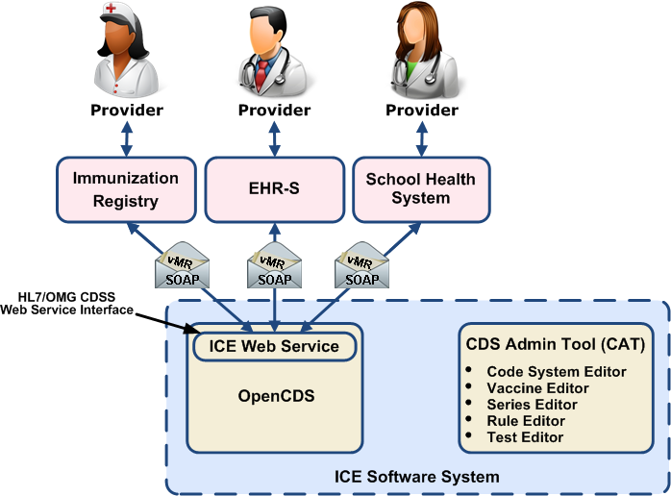
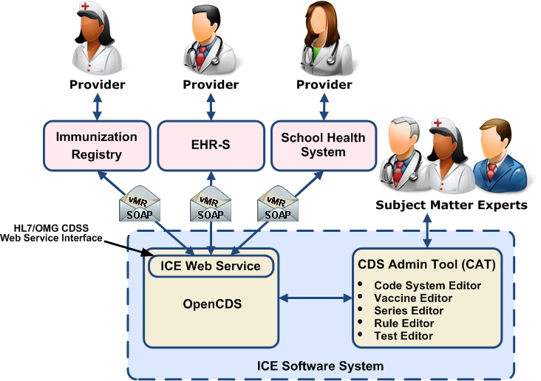
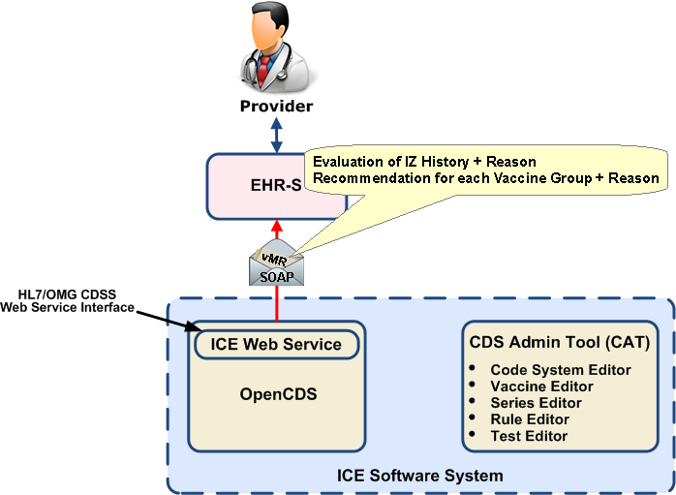
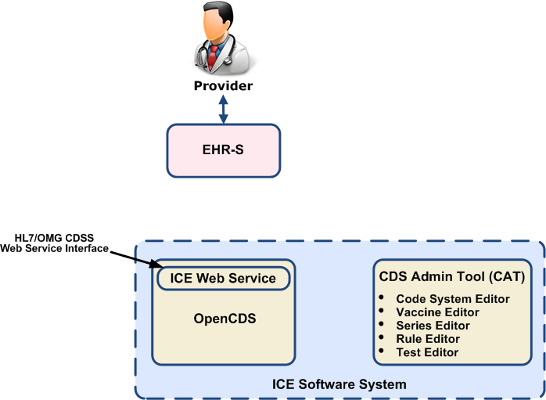
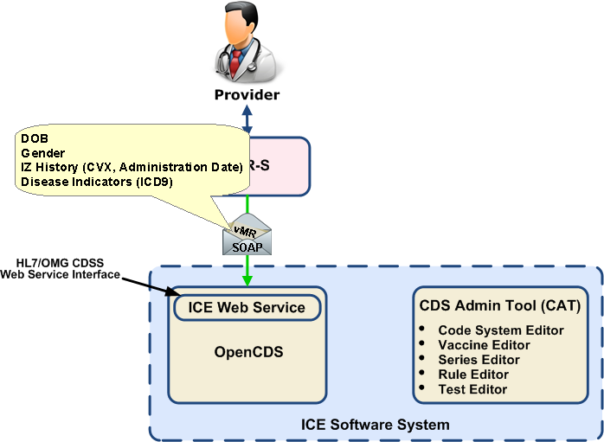
Sample ICE Deployment
43
Notes:
43

Slide 44
ICE Web Service
Standards-Based
HL7 Virtual Medical Record (vMR) Release 1
HL7 Decision Support Service (DSS) Release 1
Operates on the OpenCDS platform (www.opencds.org)
Complete knowledge authoring platform; provides messaging and reasoning over the vMR data model
Separates terminology management from logic engineering
Reference implementation for DSS and vMR standards
Inputs:
DOB, gender, immunization history, disease immunity, Immunization schedule identifier, date of evaluation (via DSS)
Outputs:
Validity of immunization history, immunization recommendations + reasons
Rules are implemented in Drools; DSL (“sentence templates”) available for rule authors
44

Slide 45
CDS Administration Tool (CAT)
Optional GUI for authoring and testing rules
Geared for “non-developer” SMEs to view and/or configure rules; develop test cases
Supports creation, maintenance, importing & exporting:
OpenCDS concepts and codes
Rules
Supporting data
Test cases (ICE-specific module)
Defining immunization schedule parameters (ICE-specific module)
Extensible “plug-in” architecture
May be used in conjunction with other development environments

Slide 46
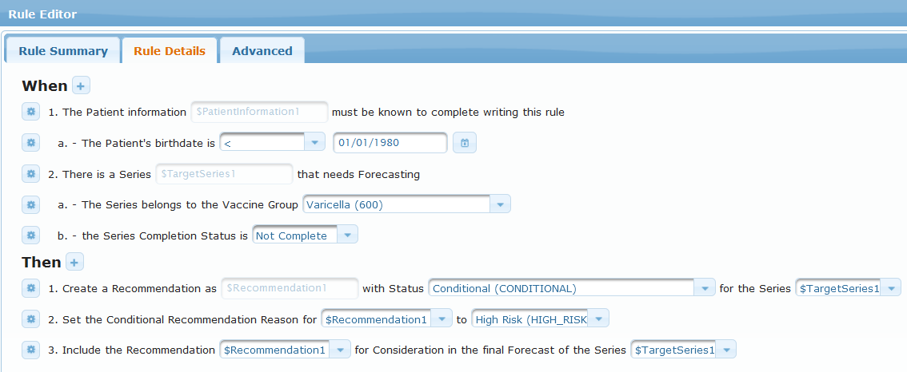
Sample Varicella Rule
Notes:
20 seconds

Slide 47
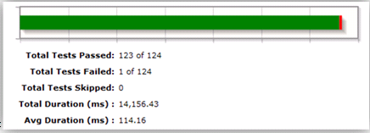
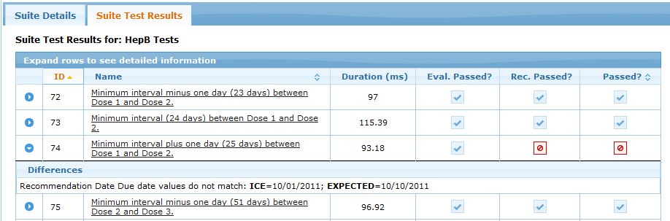
Live Testing (Test Results View)
Notes:
Immediately rerun failed test

Slide 48
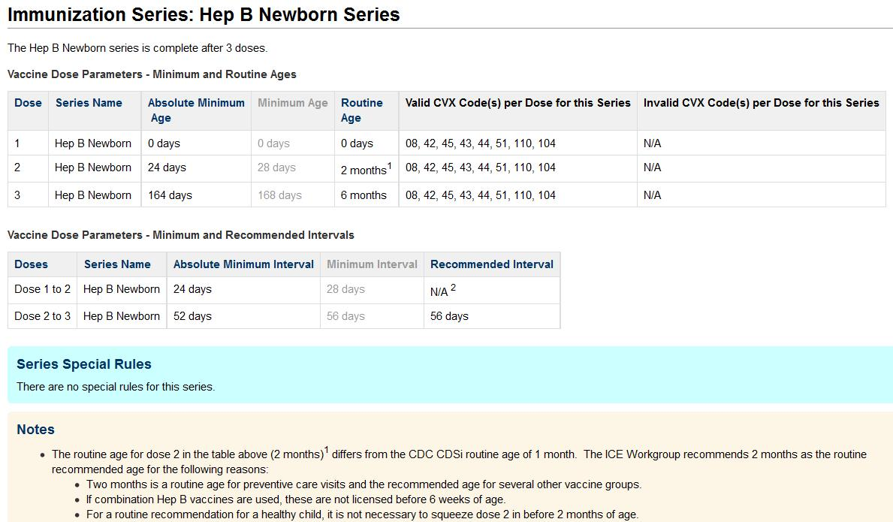
Wiki Documentation of Rules http://www.cdsframework.org
Notes:
20 seconds

Slide 49
ICE Lessons Learned
Notes:
49

Slide 50
HLN’s Observations
Agreement on and documenting the rules (unequivocally) is challenging!
Our principles are aligned with those of HeD Use Case 2
DSS and vMR
The advantages of selecting a platform that implemented the DSS and vMR standards “out of the box”
For our use case, the vMR data model is not difficult to learn
Immunization forecasting is not difficult to model; works well for messaging and reasoning
eClinicalWorks & ICE testers have incorporated ICE with minimal support from ICE team
vMR release 1 is missing some semantics for immunization forecasting; many new, useful semantics have been added in vMR release 2
Encouraging CDS consumers to adopt your CDS service
Write (and share!) an implementation guide for your use case, especially if templates are not available
Adopt standards & use templates where possible
Offer sample software clients to interact with your service

Slide 51
Future Directions for ICE
Complete Version 1.0 and Open Source version
Ongoing update of immunization rules and software
Continued alignment with evolving CDS standards to foster (easier) adoption across diverse settings
Investigate expressing the ICE rule set according to the CDS Knowledge Artifact schema
Divorces the computable ICE rules from the ICE software
Investigate upgrading to HL7 DSS Release 2 and vMR Release 2

Slide 52
HeD in the “Real World”
Julie Scherer, PhD
Chief Data Scientist, Motive Medical Intelligence
Robin Williams, RN
Manager Solution Management, Allscripts
Howard Strasberg, MD, MS
VP Medical Informatics, Clinical Solutions , Wolters Kluwer
Notes:
Julie

Slide 53
Words from the “Real World”
Portable CDS assets
Developed and distributed by Motive Medical Intelligence
Use a format derived from the HeD knowledge artifact specification
Employ a subset of the vMR and HeD expression language
Consumed by and executed natively in consuming HIT systems
Allscripts finds value in the
standardization of rule definitions
plans to consume artifacts defined in the HeD format.
We are curious about the adoption of HeD by authors and the opportunities for business relationships.
We are hopeful that as HeD defined content is more readily available, our CDS projects can focus more on the user experience and less on technical integrations.
Notes:
Julie/Robin/Howard

Slide 54
Path Forward
The HeD Initiative will come to completion March 31, 2014
The HeD work will inform the new Clinical Quality Framework Initiative which launches this week (March 21st from 12-1pm ET)
http://wiki.siframework.org/Clinical+Quality+Framework+Initiative
Notes:
Ken

Slide 55

“People who say it can’t be done
should get out of the way
of people who are doing it.”
Borrowed from Victor Lee (Zynx Health) and what must have been a fortuitous dinner… his summary of HeD
Notes:
Ken

Slide 56
Celebrating our Community
A gigantic heart felt and humble:
Thank You
While we have achieved tremendous success – getting the chance and the honor of working with each and every one of you was the highlight of this chaotic, funny and ever changing adventure
Notes:
Ken/Alicia

Slide 57
Thoughts

Slide 58
Useful S&I Wiki Links
Wiki
http://wiki.siframework.org/Health+eDecisions+Homepage
Use Case 1& 2
http://wiki.siframework.org/Health+eDecisions+Use+Case
UC 2: Use Case 2: http://wiki.siframework.org/UC+2+-+CDS+Guidance+Service
Pilots
http://wiki.siframework.org/Health+eDecisions+Pilots
HL7 Ballot Submission:
http://wiki.siframework.org/Health+eDecisions+Reference+Materials#Ballot
UC 1 Harmonization and IG:
http://wiki.siframework.org/Health+eDecisions+Harmonization+and+Standards+%28Implementation%29
HeD Glossary
http://wiki.siframework.org/HeD+Glossary

Slide 59
Contacts:
Please feel free to reach out to any member of the Health eDecisions Initiative team:
ONC Sponsors
Jacob Reider :Jacob.Reider@hhs.gov
Alicia Morton: alicia.morton@hhs.gov
Initiative Coordinator:
Ken Kawamoto: kensaku.kawamoto@utah.edu
Tonya Hongsermeier
Subject Matter Experts:
Aziz Boxwala: aziz.boxwala@meliorix.com
Bryn Rhodes: bryn@veracitysolutions.com
Support Team:
Project Management: Jamie Parker jamie.parker@esacinc.com
Use Case Development: Virginia Riehl: virginia.riehl@verizon.net
Standards and Harmonization: Anna Langhans anna.langhans@accenturefederal.com, Atanu Sen atanu.sen@accenture.com, Divya Raghavachari divya.raghavachari@accenturefederal.com

Slide 60
Extra Slides

Slide 61
Clinical Decision Support to Health eDecisions - a brief history…
Content suppliers and EHR/PHR vendors all have proprietary formats and methods for exchanging, implementing, life-cycle managing, and executing CDS interventions
Each content supplier-EHR/PHR vendor integration for CDS exchange is unique
No widely accepted/adopted standards for exchange or services insertion
Even within a vendor, clients cannot always exchange content with each other
Healthcare systems with successful implementation of CDS are unable to share their proven interventions with others in an importable format, even if they wished to
Notes:
Ken

Slide 62
Clinical Decision Support to Health eDecisions - a brief history continued
Barriers exist to the adoption and implementation of CDS despite research demonstrating effectiveness in improving quality and safety
Lack of widely accepted, implementable standards for importing and/or sharing proven CDS interventions (reminders, order sets, documentation templates)
ONC and AHRQ have invested in multiple research projects such as GLIDES, CDSC, ACDS and eRecs to advance CDS implementation, sharing and adoption
In April 2012, ONC and AHRQ gathered stakeholders from across the vendor, academic, and healthcare communities to discuss how to advance the shareability of CDS interventions and build on the work and existing standards to date, resulting in the Health eDecisions Initiative

Slide 63
Deliverables Overview
Foundational Deliverables
Functional requirements, including scope specification, use cases, and data requirements
Analysis of relevant efforts (esp. standards)
Standards
HL7 Virtual Medical Record (multiple facets)
HL7 Decision Support Service Release 2
Use Case 1 and 2 implementation guides

Slide 64
vMR Background
A “holy grail” of clinical informatics is scalable, interoperable CDS
Key requirement for interoperable CDS and re-use of CDS knowledge resources = use of a common patient data model
Referred to as a “Virtual Medical Record” or vMR (Johnson et al., AMIA Annu Symp Proc, 2001)
Needs to be easy and safe for a typical CDS knowledge engineer to understand and use
Lack of a common vMR has been a major barrier to sharing knowledge and scaling CDS
Notes:
SCT 14May

Slide 65
vMR Goal
Provide standard information model for CDS that (i) can be used across CDS implementations and (ii) is simple and intuitive for a typical CDS knowledge engineer to understand, use, and implement

Slide 66
Development Methodology
Analysis of data required by 20 CDS systems from 4 countries (Kawamoto et al., AMIA 2010)
Analysis of various standard information models
HL7 CCD, C-CDA, QRDA, Pedigree model, Clinical Statement pattern, etc.
Analysis of orderables from hundreds of hospitals
Iterative refinement from pilot use
In particular, through OpenCDS (www.opencds.org) and HeD pilots
Initial ballot in 2010; now in 5th round of balloting

Slide 67
Summary of vMR Specifications
HL7 vMR Domain Analysis Model
HL7 vMR Logical Model
HL7 vMR XML Specification
HL7 vMR Templates
See http://wiki.hl7.org/index.php?title=HL7_CDS_Standards for further details

Slide 68
CDS Knowledge Artifact Schema
Format for specifying computable CDS knowledge
Harmonization of several formats and ideas
CDSC-L3, ArdenML, CREF
Other inputs (GELLO, GEM, HQMF, ...)
Components
Metadata, Expressions, Actions, Triggers
Foundation data model: vMR

Slide 69
Expressions
External Data
Specifies the data required to evaluate the artifact
Expressions
Reusable “chunks” of logic that can be referenced anywhere within the artifact
Conditions
“Root” conditions of the artifact (e.g. ApplicableScenario)

Slide 70
External Data Example
<def name="PertussisProblems">
<expression xsi:type="ClinicalRequest" dataType="vmr:Problem" cardinality="Multiple“ isInitial="true" useValueSets="true" dateProperty="diagnosticEventTime.begin" codeProperty="problemCode" triggerType="DataElementAdded">
<description>Pertussis problem</description>
<codes xsi:type="ValueSet" id="2.16.840.1.114222.4.11.7005" version="1"/>
</expression>
</def>

Slide 71
Expressions Example
<def name="ActivePertussisProblems">
<expression xsi:type="Filter">
<description>Problem status is not resolved or not inactive. In other words,
the problem is active or status is not specified</description>
<source xsi:type="ExpressionRef" name="PertussisProblems"/>
<condition xsi:type="Not">
<operand xsi:type="In">
<element xsi:type="Property" path="problemStatus"></element>
<collection xsi:type="List">
<element xsi:type="CodeLiteral“ displayName="Inactive"
codeSystem="2.16.840.1.113883.6.96" code="73425007" />
<element xsi:type="CodeLiteral" displayName="Resolved“
codeSystem="2.16.840.1.113883.6.96" code="413322009" />
</collection>
</operand>
</condition>
</expression>
</def>

Slide 72
Conditions Example
<condition>
<logic xsi:type="And">
<description>(Patient lives in SD or Care encounter was in SD) and
(Diagnosed with Pertussis or Cause of Death was Pertussis
or culture results positive for pertussis)</description>
<operand xsi:type="Or">
<operand xsi:type="ExpressionRef" name="PatientLivesInSDCounty"/>
<operand xsi:type="ExpressionRef" name="EncounterWasInSDCounty"/>
</operand>
<operand xsi:type="Or">
<!-- Necessary clinical conditions -->
<operand xsi:type="ExpressionRef" name="HasActivePertussisProblems"/>
<operand xsi:type="ExpressionRef" name="DeathWasCausedByPertussis"/>
<operand xsi:type="ExpressionRef" name="HasPositivePertussisCulture"/>
</operand>
</logic>
<conditionRole value="ApplicableScenario"/>
</condition>

Slide 73
Actions
Message Action
Create/Modify/Remove Action
Indicates proposal for some action
e.g. create a SubstanceAdministrationProposal
create a CommunicationProposal
Collect Information Action
Defines information to be collected
Action Groups
Provide structure for grouping actions

Slide 74
Message Action
<simpleAction xsi:type="CreateAction">
<actionSentence xsi:type="ObjectExpression"
objectType="vmr:CommunicationProposal">
<property name="message">
<value xsi:type="ComplexLiteral">
<value xsi:type="dt:ED" value="This patient has or is suspected of having pertussis. Patients diagnosed with or suspected of having pertussis must be reported to County of San Diego Health and Human Services Agency within one working day of identification or suspicion"/>
</value>
</property>
</actionSentence>
</simpleAction>

Slide 75
Triggers
Data Event
Triggers on data modification
e.g. When a Substance Administration is added to the patient data
Periodic
Triggers on a recurring schedule
e.g. Every morning at 2:00AM

Slide 76
Data Event Trigger
<def name="PertussisProblems">
<expression xsi:type="ClinicalRequest" dataType="vmr:Problem" cardinality="Multiple“ isInitial="true" useValueSets="true" dateProperty="diagnosticEventTime.begin" codeProperty="problemCode" triggerType="DataElementAdded">
<description>Pertussis problem</description>
<codes xsi:type="ValueSet" id="2.16.840.1.114222.4.11.7005" version="1"/>
</expression>
</def>
<trigger>
<eventType>DataEvent</eventType>
<expression xsi:type="ExpressionRef" name="PertussisProblems"/>
</trigger>

Slide 77
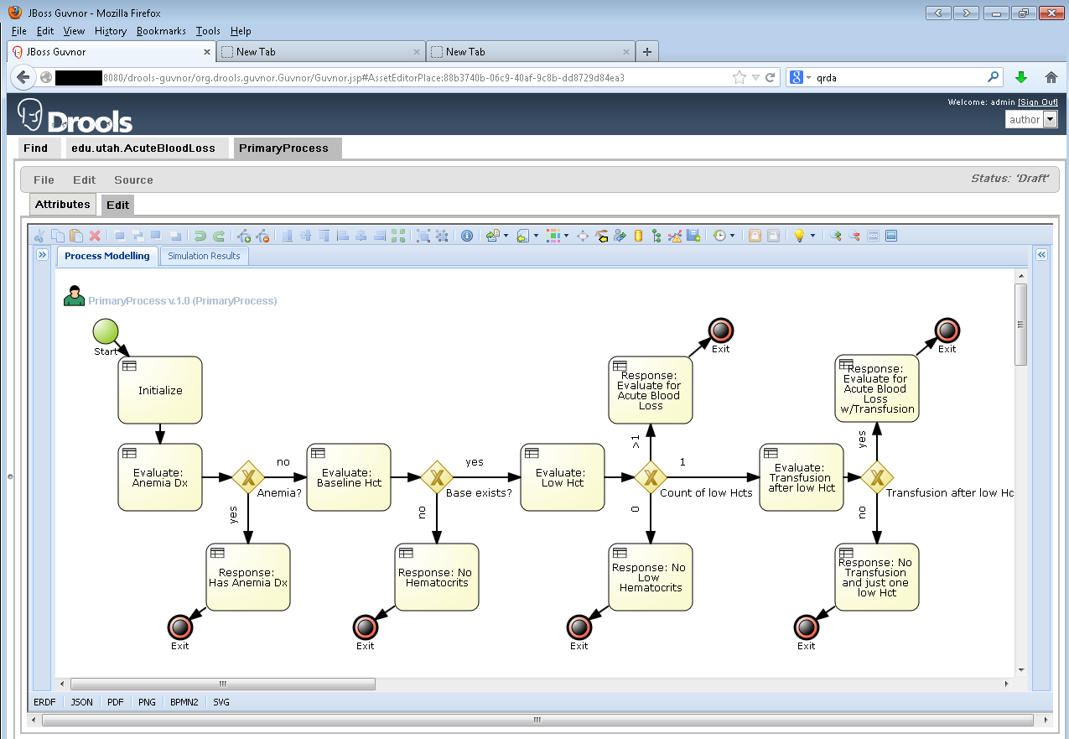
OpenCDS Knowledge Editor

Slide 78
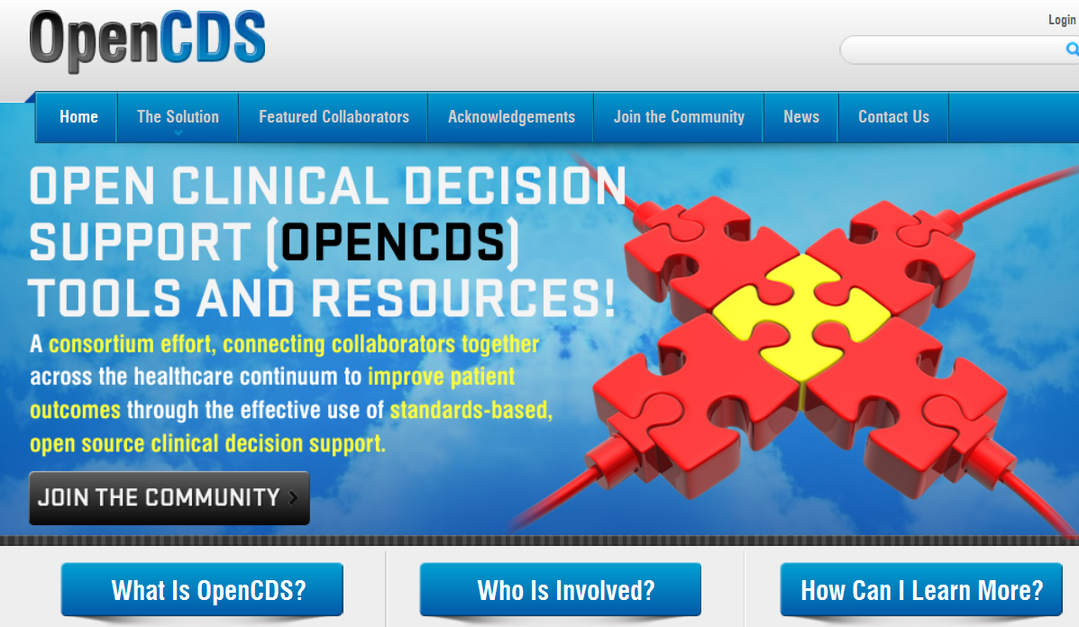
www.OpenCDS.org

Slide 79
HeD Schema Framework Tool Design Goals
Notes:
Bryn

Slide 80
HeD Schema Framework Tool Current Status
The Framework currently supports
Semantic Validation
Verifies correct types for all logic in the artifact
Verifies model property and object type references
Translation Infrastructure
Supports both syntax and model transformation
Translation to CREF
~70% complete syntax
~30% complete model transformation
In Progress
Schematron Validation
Update for vMR R2 (being balloted as part of UC2 work streams)
Notes:
Bryn

Slide 81
HeD Schema Framework Tool Translation Example
Notes:
Bryn

Slide 82
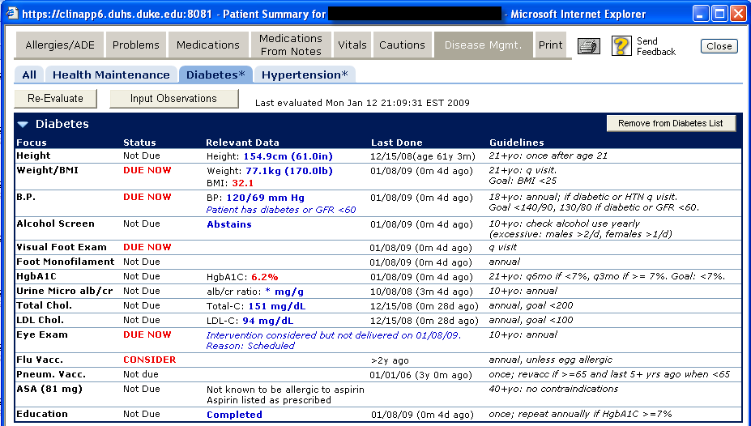
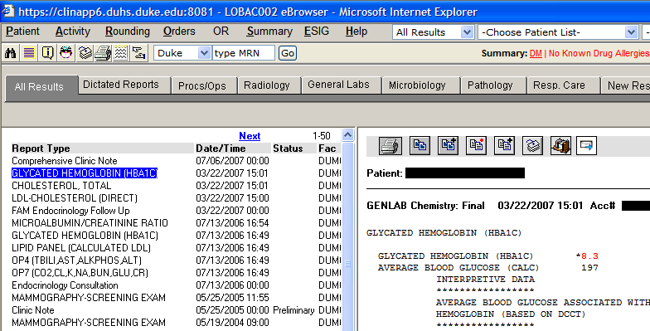
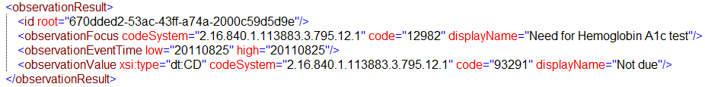
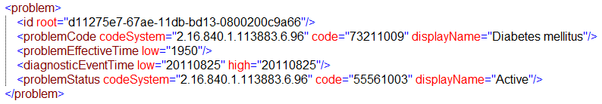
CDS Guidance Service – Example
Eval. Result
vMR
Decision Support Service
EHR System
Notes:
SCT 14May
Bryn do you want to talk through this slide??

